Slide 1
Python Programming Language
Lecture 6: If –Else and Problem Solving
Hafsa Sultana
Computer Science and Engineering
Khulna University

Slide 2
Today’s Learning Objectives
Decision Making
Conditional Statements
If-Else Constructs
Practical Exercises
Hafsa Sultana, CSE, KU

Slide 3
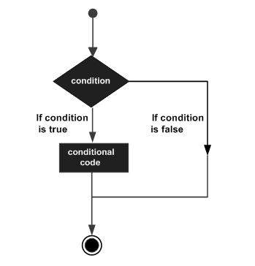
Decision Making
Decision structures evaluate multiple expressions that produce TRUE or FALSE as outcome.
Hafsa Sultana, CSE, KU

Slide 4
What are Conditional Statements?
Definition: Instructions that only run when a certain condition is true.
Importance: Allows programs to make decisions and execute different code paths.
Logical conditions:
Equals: a == b
Not Equals: a != b
Less than: a < b
Less than or equal to: a <= b
Greater than: a > b
Greater than or equal to: a >= b
Hafsa Sultana, CSE, KU

Slide 5
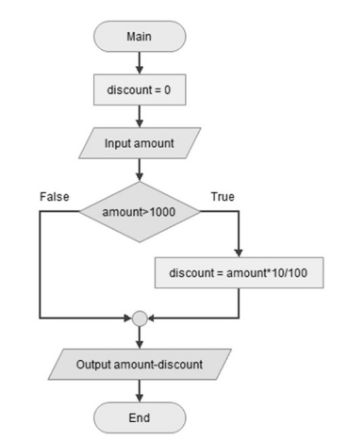
If Statement
Let us consider an example of a customer entitled to 10% discount if his purchase amount is > 1000; if not, then no discount is applicable.
Hafsa Sultana, CSE, KU

Slide 6
Simple If Statement
Syntex: if expression:
statement(s)
if condition:
# code to execute if the condition is true
Example: Check if a number is positive
num = 5
if num > 0:
print("The number is positive")
Hafsa Sultana, CSE, KU

Slide 7
If-Else Statement
Syntax:
if condition:
# code to execute if condition is true
else:
# code to execute if condition is false
Example: Check if a number is even or odd.
num = 4
if num % 2 == 0:
print("The number is even")
else:
print("The number is odd")
Hafsa Sultana, CSE, KU

Slide 8
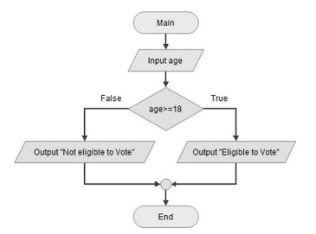
If-Else Statement
Example: The variable age can take different values. If the expression "age > 18" is true, the message you are eligible to vote is displayed otherwise not eligible message should be displayed.
Code:
age=25
print ("age: ", age)
if age >=18:
print ("eligible to vote")
else:
print ("not eligible to vote")
Hafsa Sultana, CSE, KU

Slide 9
If-Elif-Else Statement
Syntax:
if condition1:
# code to execute if condition1 is true
elif condition2:
# code to execute if condition2 is true
else:
# code to execute if both conditions are false
Example: Determine the grade based on marks.
marks = 85
if marks >= 90:
print("Grade: A")
elif marks >= 80:
print("Grade: B")
else:
print("Grade: C")
Hafsa Sultana, CSE, KU

Slide 10
Short Hand If ... Else
Example:
a = 2
b = 330
print("A") if a > b else print("B")
Hafsa Sultana, CSE, KU

Slide 11
Nested If Statements
Definition: An if statement inside another if statement.
Example: Check if a number is positive and even.
num = 6
if num > 0:
if num % 2 == 0:
print("The number is positive and even")
else:
print("The number is positive but odd")
else:
print("The number is not positive")
Hafsa Sultana, CSE, KU

Slide 12
Using Boolean Operators
Boolean operators: and, or, not
Example: Check if a number is positive and less than 10.
num = 7
if num > 0 and num < 10:
print("The number is positive and less than 10")
Hafsa Sultana, CSE, KU

Slide 13
If-Else with Strings
Example: Check if a string is empty.
my_string = “”
if my_string == “”:
print("The string is empty")
else:
print("The string is not empty")
Hafsa Sultana, CSE, KU

Slide 14
If-Else with Lists
Example: Check if a list contains an item.
my_list = [1, 2, 3, 4, 5]
if 3 in my_list:
print("3 is in the list")
else:
print("3 is not in the list")
Hafsa Sultana, CSE, KU

Slide 15
Practical Example 1
Check if a user is old enough to vote.
age = 18
if age >= 18:
print("You are old enough to vote")
else:
print("You are not old enough to vote")
Hafsa Sultana, CSE, KU

Slide 16
Practical Example 2
Determine if the temperature is hot, cold, or just right.
temperature = 25
if temperature > 30:
print("It's hot")
elif temperature < 15:
print("It's cold")
else:
print("The temperature is just right")
Hafsa Sultana, CSE, KU

Slide 17
Common Mistakes
Forgetting the colon: after the condition.
Incorrect indentation.
Using = instead of == for comparison.
Hafsa Sultana, CSE, KU

Slide 18
Debugging Tips
Use print statements to check variable values.
Carefully read error messages.
Test each condition separately.
Hafsa Sultana, CSE, KU

Slide 19
Practical Exercise 3
Title: Guessing Game
Write a program that asks the user to guess a number.
secret_number = 7
guess = int(input("Guess the number: "))
if guess == secret_number:
print("You guessed it!")
else:
print("Try again!").
Hafsa Sultana, CSE, KU

Slide 20
Practical Exercise 4
Title: Password Check
Write a program that checks if a password is correct.
password = "python123"
user_input = input("Enter the password: ")
if user_input == password:
print("Access granted")
else:
print("Access denied")
Hafsa Sultana, CSE, KU

Slide 21
Practical Exercise 5
Title: Leap Year
Write a program that checks if a password is correct.
Year = int(input("Enter the number: "))
if((Year % 400 == 0) or (Year % 100 != 0) and (Year % 4 == 0)):
print("Given Year is a leap Year");
else:
print ("Given Year is not a leap Year")
Hafsa Sultana, CSE, KU

Slide 22
Recap
Conditional Statements
If-Else Constructs
Elif and Nested If Statements
Practical Examples
Hafsa Sultana, CSE, KU

Slide 23
Any Question?

Slide 24
References
https://www.w3schools.com/python/
https://www.tutorialspoint.com/python/
Hafsa Sultana, CSE, KU

Slide 25
EXAM-1

Slide 26
Problem 1
non_start
Given 2 strings, return their concatenation, except omit the first char of each. The strings will be at least length 1.
non_start('Hello', 'There') → 'ellohere'
non_start('java', 'code') → 'avaode'
non_start('shotl', 'java') → 'hotlava''
Hafsa Sultana, CSE, KU

Slide 27
Problem 2
sum_double
Given two int values, return their sum. Unless the two values are the same, then return double their sum.
sum_double(1, 2) → 3
sum_double(3, 2) → 5
sum_double(2, 2) → 8
''
Hafsa Sultana, CSE, KU

Slide 28
Problem 3
make_tags
The web is built with HTML strings like "<i>Yay</i>" which draws Yay as italic text. In this example, the "i" tag makes <i> and </i> which surround the word "Yay". Given tag and word strings, create the HTML string with tags around the word, e.g. "<i>Yay</i>".
make_tags('i', 'Yay') → '<i>Yay</i>'
make_tags('i', 'Hello') → '<i>Hello</i>'
make_tags('cite', 'Yay') → '<cite>Yay</cite>'
Hafsa Sultana, CSE, KU

Slide 29
Problem 4
love6
The number 6 is a truly great number. Given two int values, a and b, return True if either one is 6. Or if their sum or difference is 6. Note: the function abs(num) computes the absolute value of a number.
love6(6, 4) → True
love6(4, 5) → False
love6(1, 5) → True''
Hafsa Sultana, CSE, KU

